Slide 1
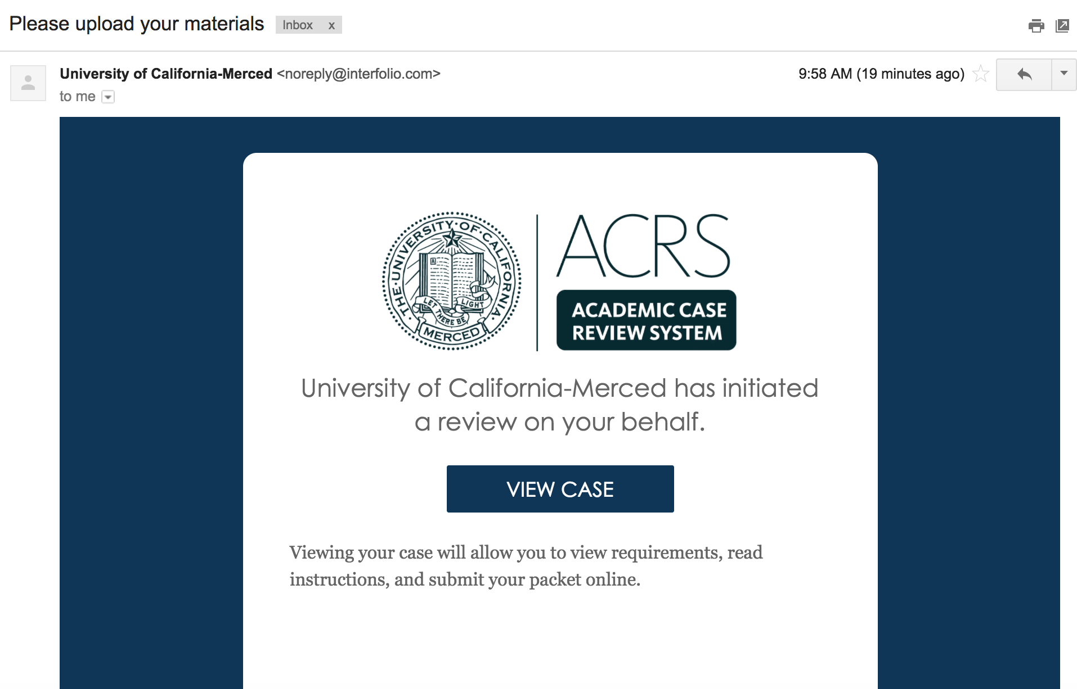
As soon as your case is created in ACRS you will receive an email (resembling the screenshot below). After you click “view case”, you will be directed to the “single sign on” page of UC Merced

Slide 2
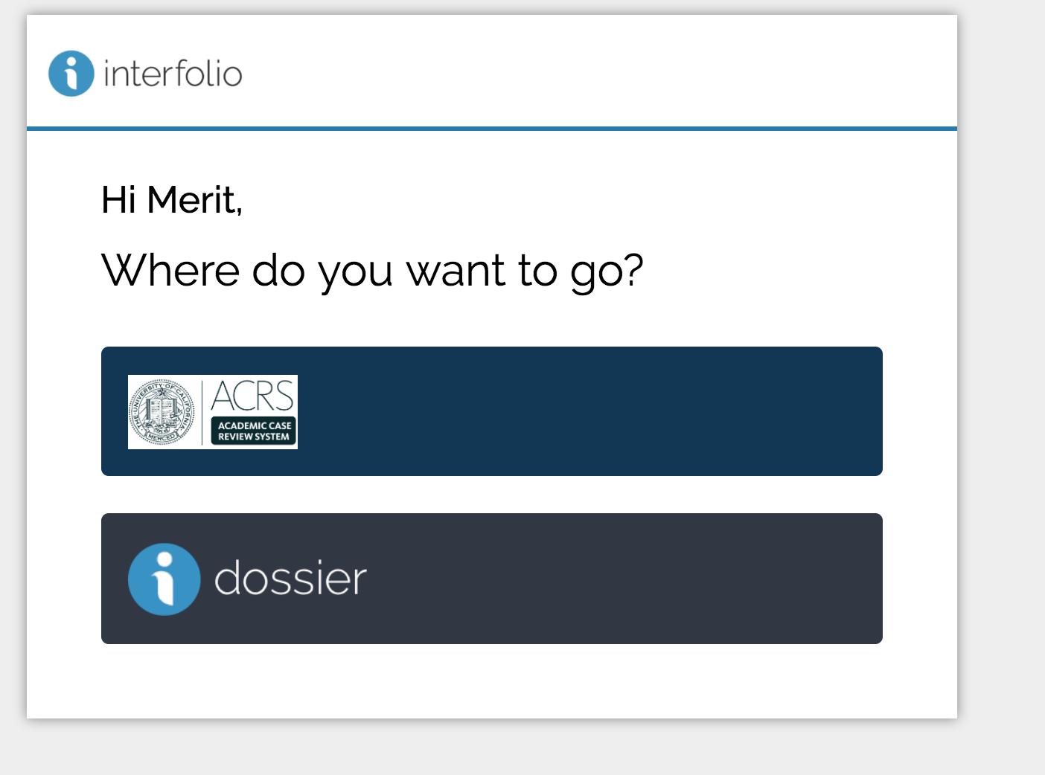

Slide 3
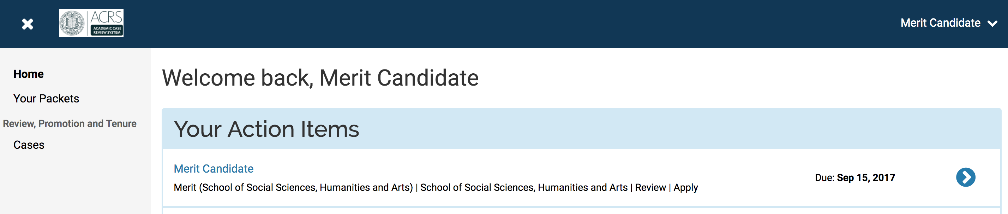

Slide 4
Please submit the exclusions as soon as possible, so that, the chairs can start forming committees. You may then leisurely prepare your materials mentioned in “candidate documents” section to submit later (before july 1)

Slide 6
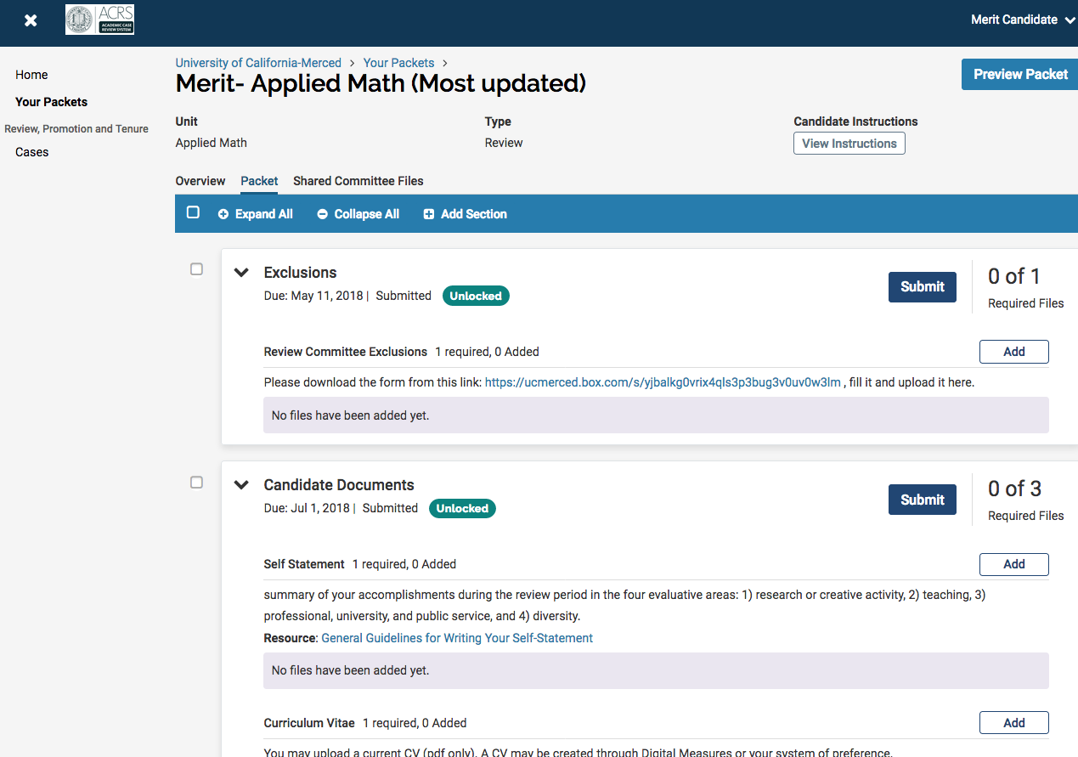
Please submit the exclusions as soon as possible, so that, the chairs can start forming committees. You may then leisurely prepare your materials mentioned in “candidate documents” section to submit later (before july 1)

Slide 7
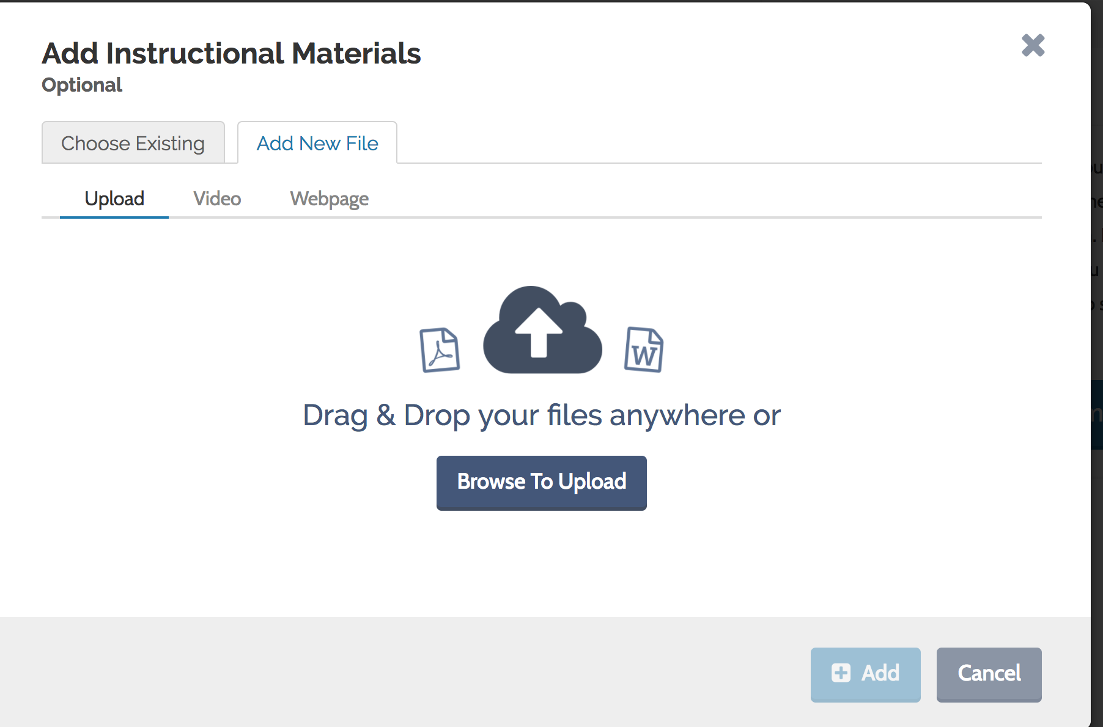

Slide 8
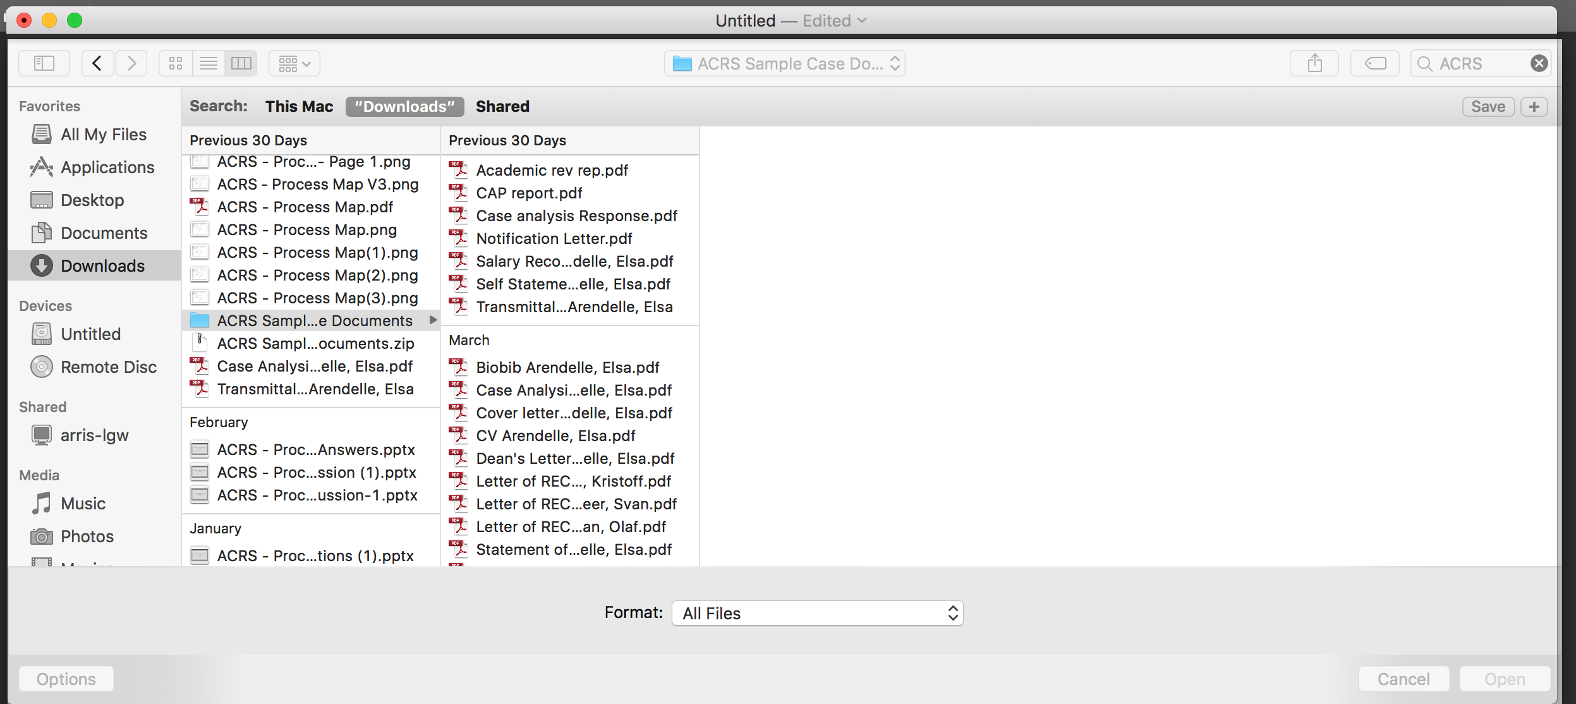

Slide 9
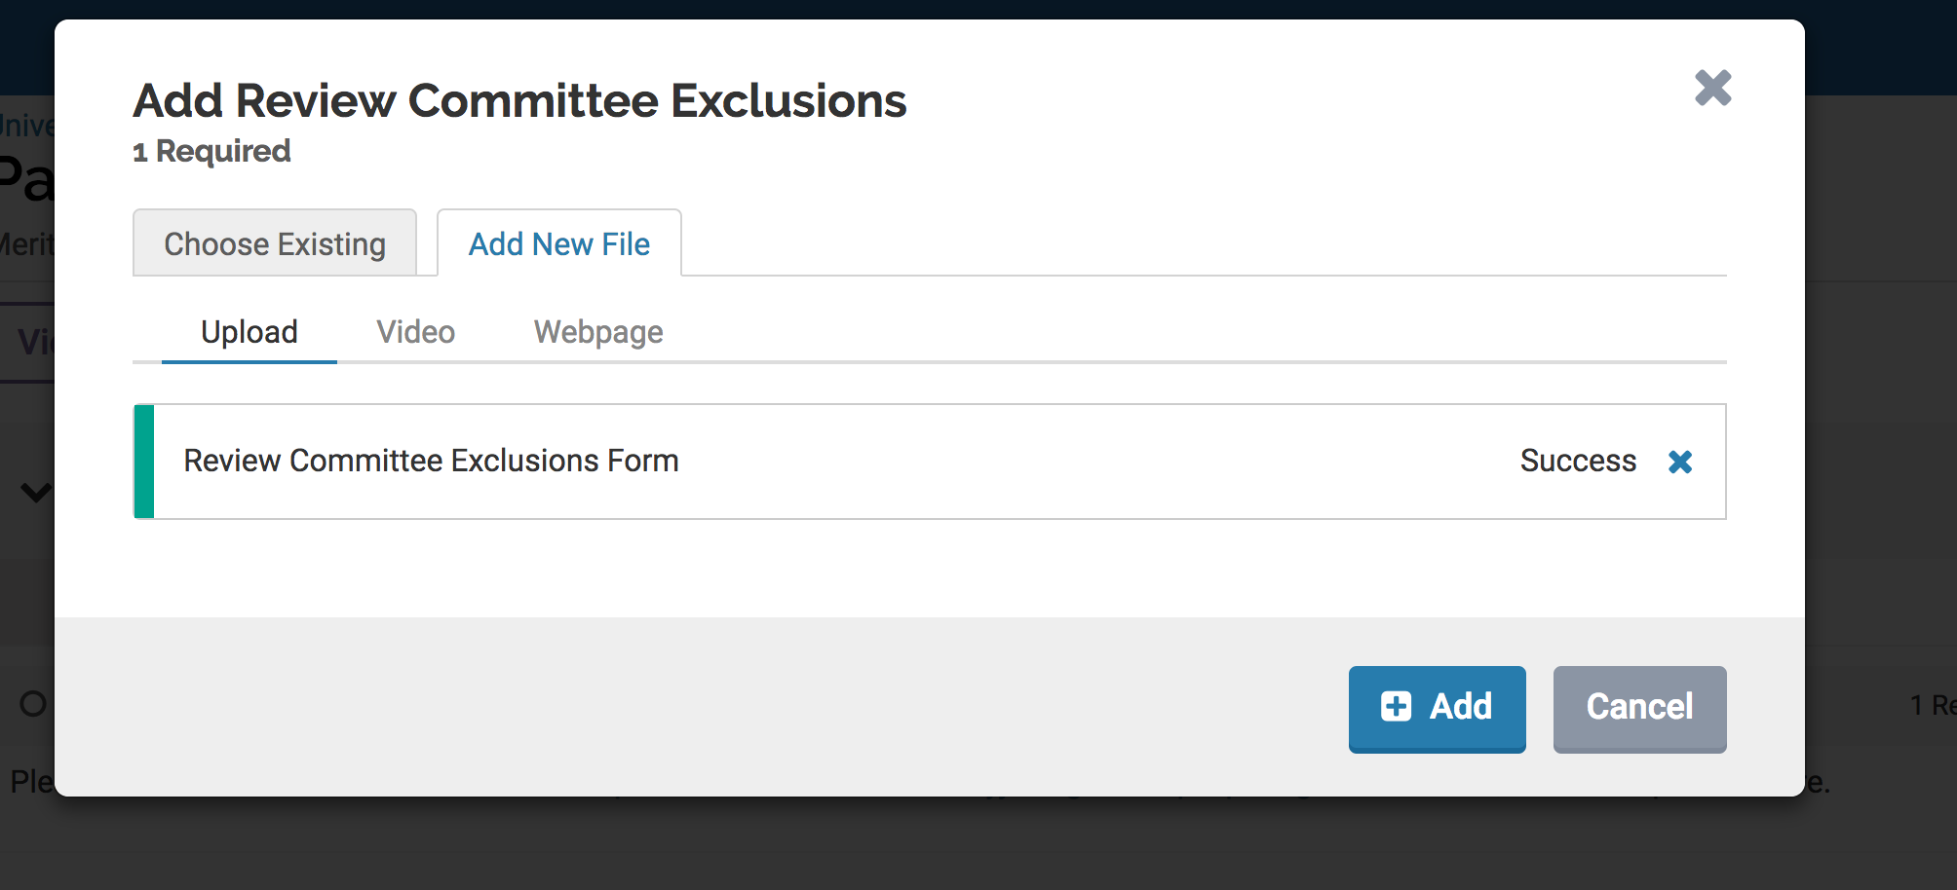

Slide 10
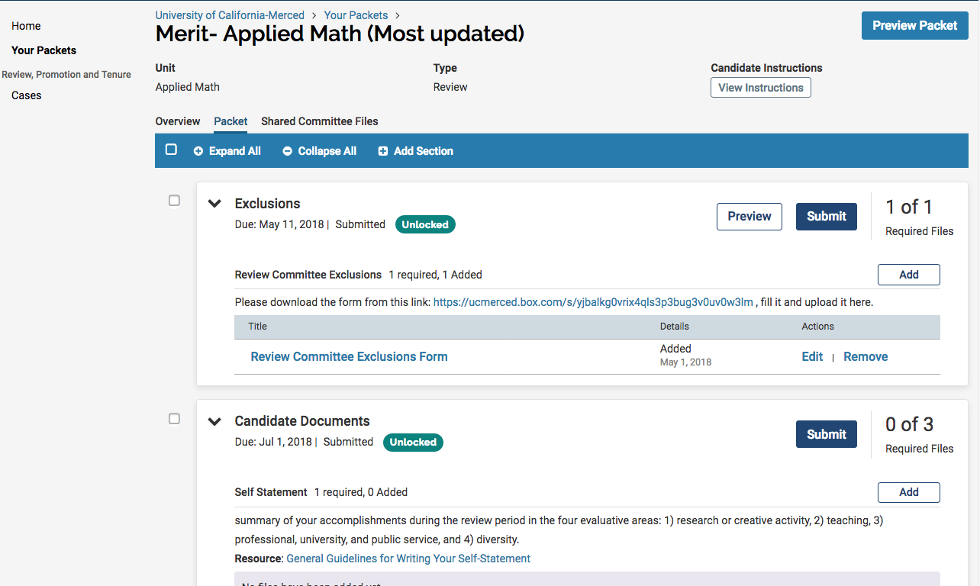

Slide 11
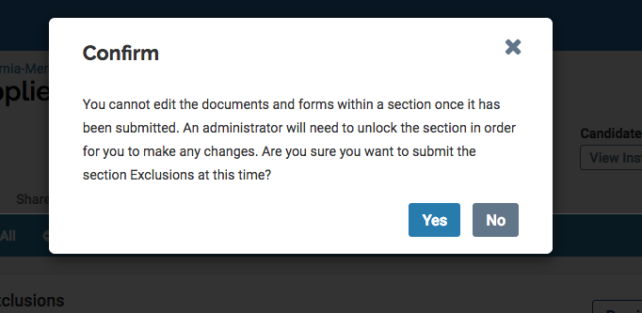

Slide 12
At this time you may either logout and work on your packet later.
Or
Continue uploading the rest of the documents and submit the “Candidate Section”

Slide 13
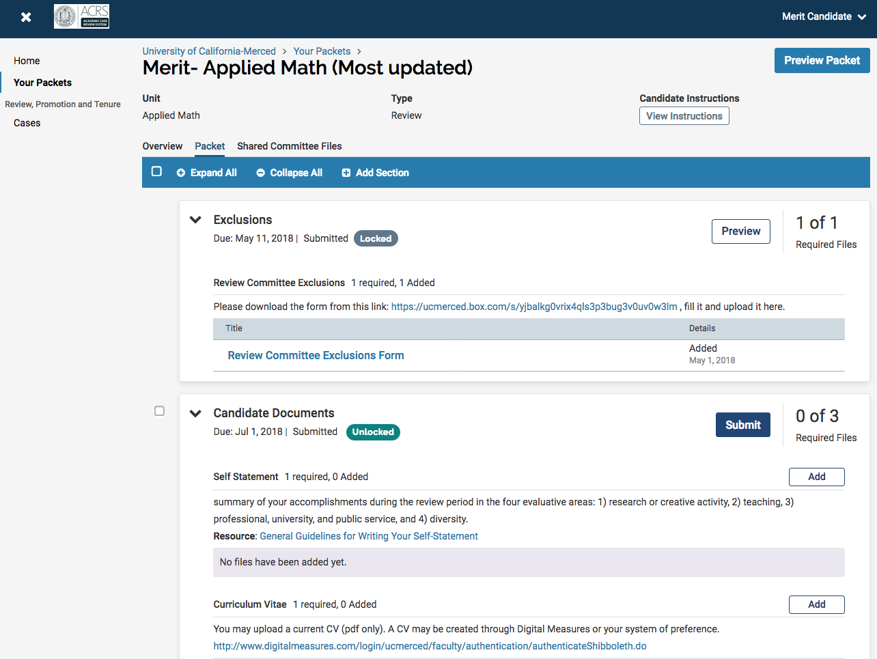

Slide 14
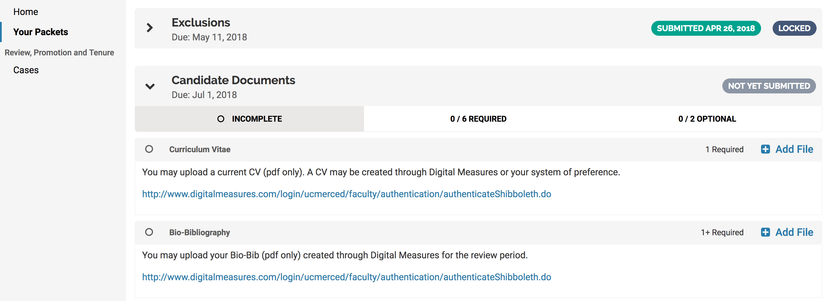

Slide 17
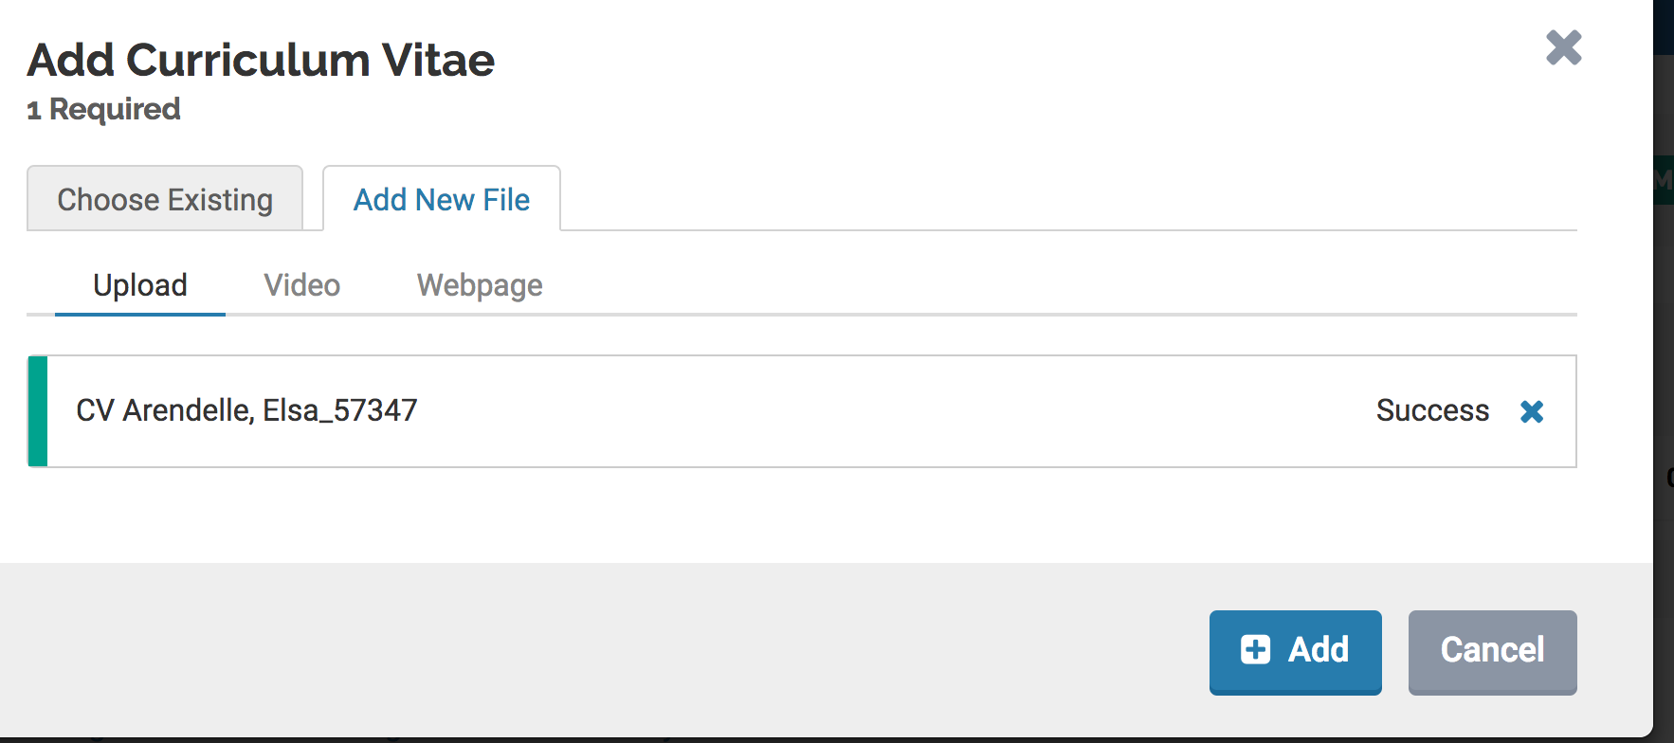

Slide 18
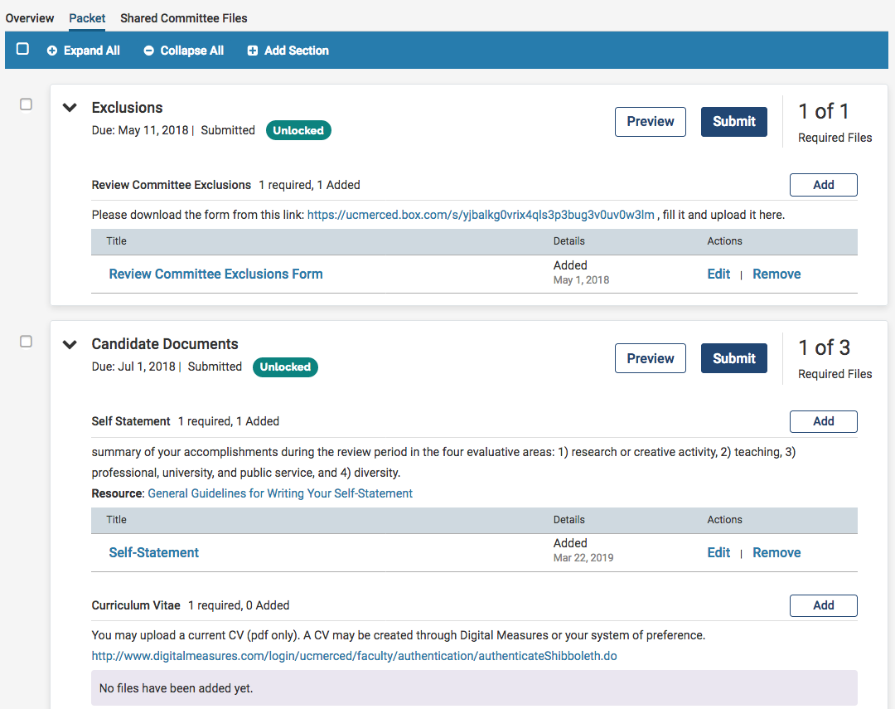

Slide 19
RESPONDING TO SHARED FILES
You will be required to use ACRS again when a Case Analysis, Transmittal Memo and a Notification Letter is shared with you.
You will be given 5 business days to respond to your Case Analysis and Transmittal Memo. Here are the instructions on how to view and respond to these two documents: View and Respond to Shared Files

Slide 20
DOSSIER
Dossier feature can be used to store all your documents in one easy location in your Interfolio account.

Slide 21
STEP 2: Please click here to view detailed instructions on how to create collections and add documents to your collections in dossier.
STEP 1: On the top right corner of your home page, click here to toggle to Dossier

