Slide 1
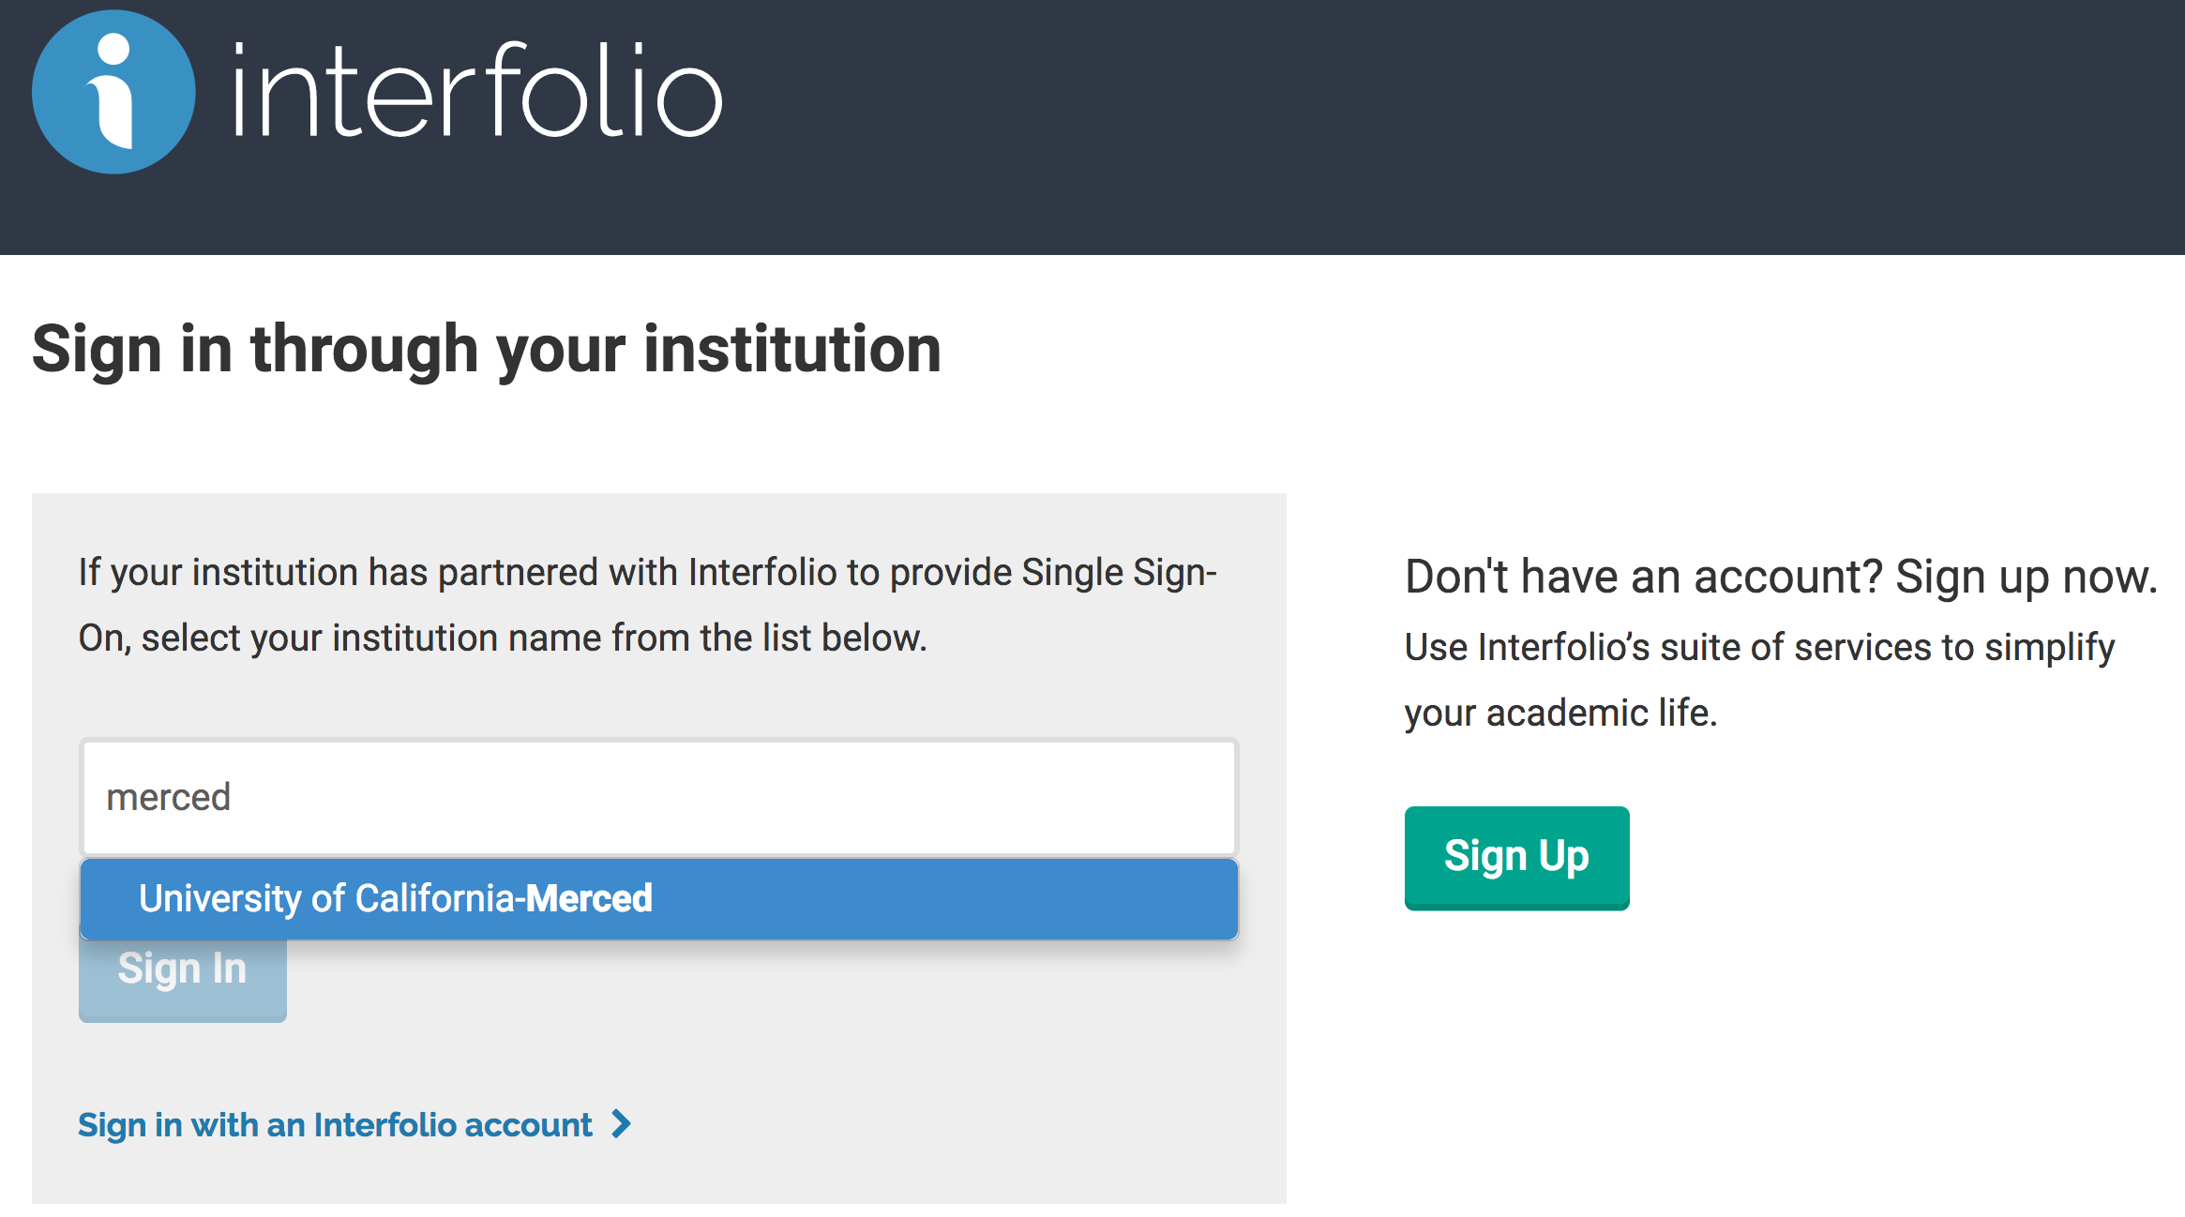
Once you log into ACRS using the link : account.interfolio.com/sso , you will see the page below. Please type in “merced” and UC Merced will show up in the dropdown. Please select “University of California-Merced” and click on “Sign in” button

Slide 2
Please type in your UCMNet ID and Password and click on “login” button in the page (below).

Slide 3
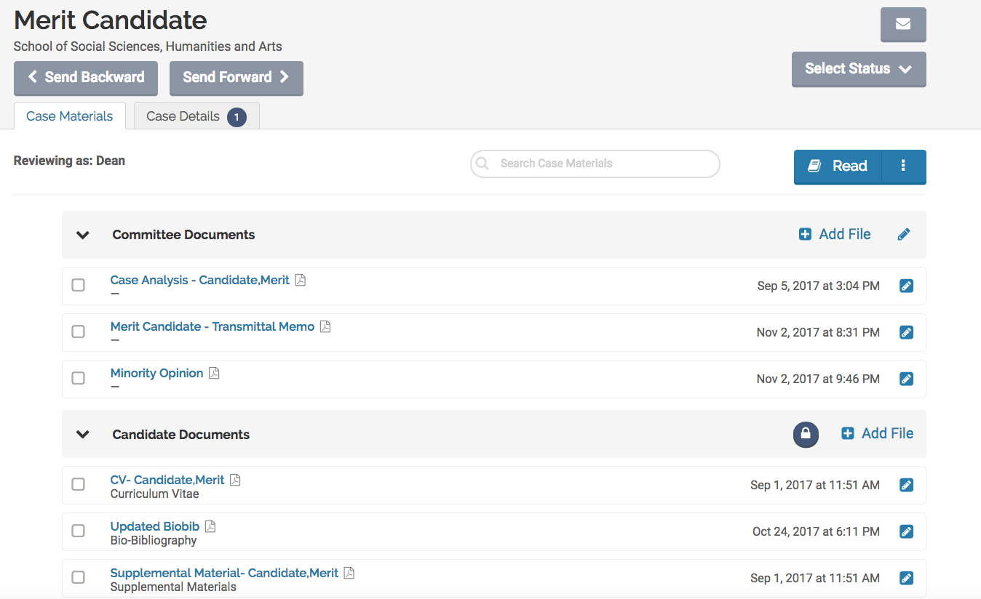
You may read the case by clicking on the “Read” button.

Slide 4
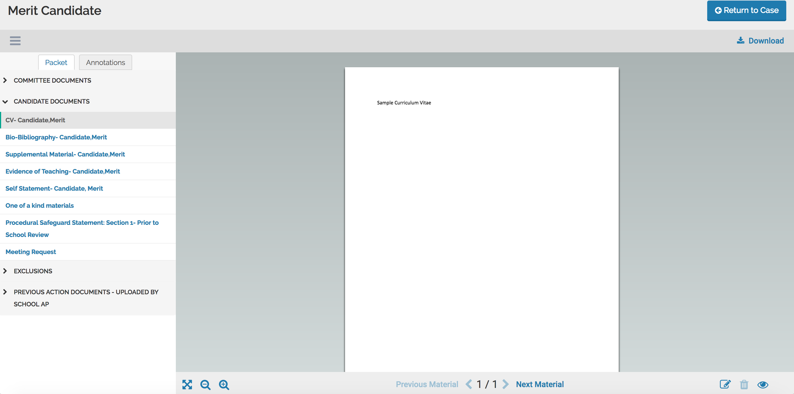
You may either click on the documents on the left hand menu to read through them, or click on “next material” button to move to the next document.

Slide 5
You may also add annotations to the candidate documents for your reference. These annotations will be private to your account and cannot be viewed by any other member.
To add annotations. Click on the edit icon (in the bottom right corner) and choose the type of annotation you would like to use. There are three choices “Point”, “Area”, ”Text” to choose from.

Slide 6
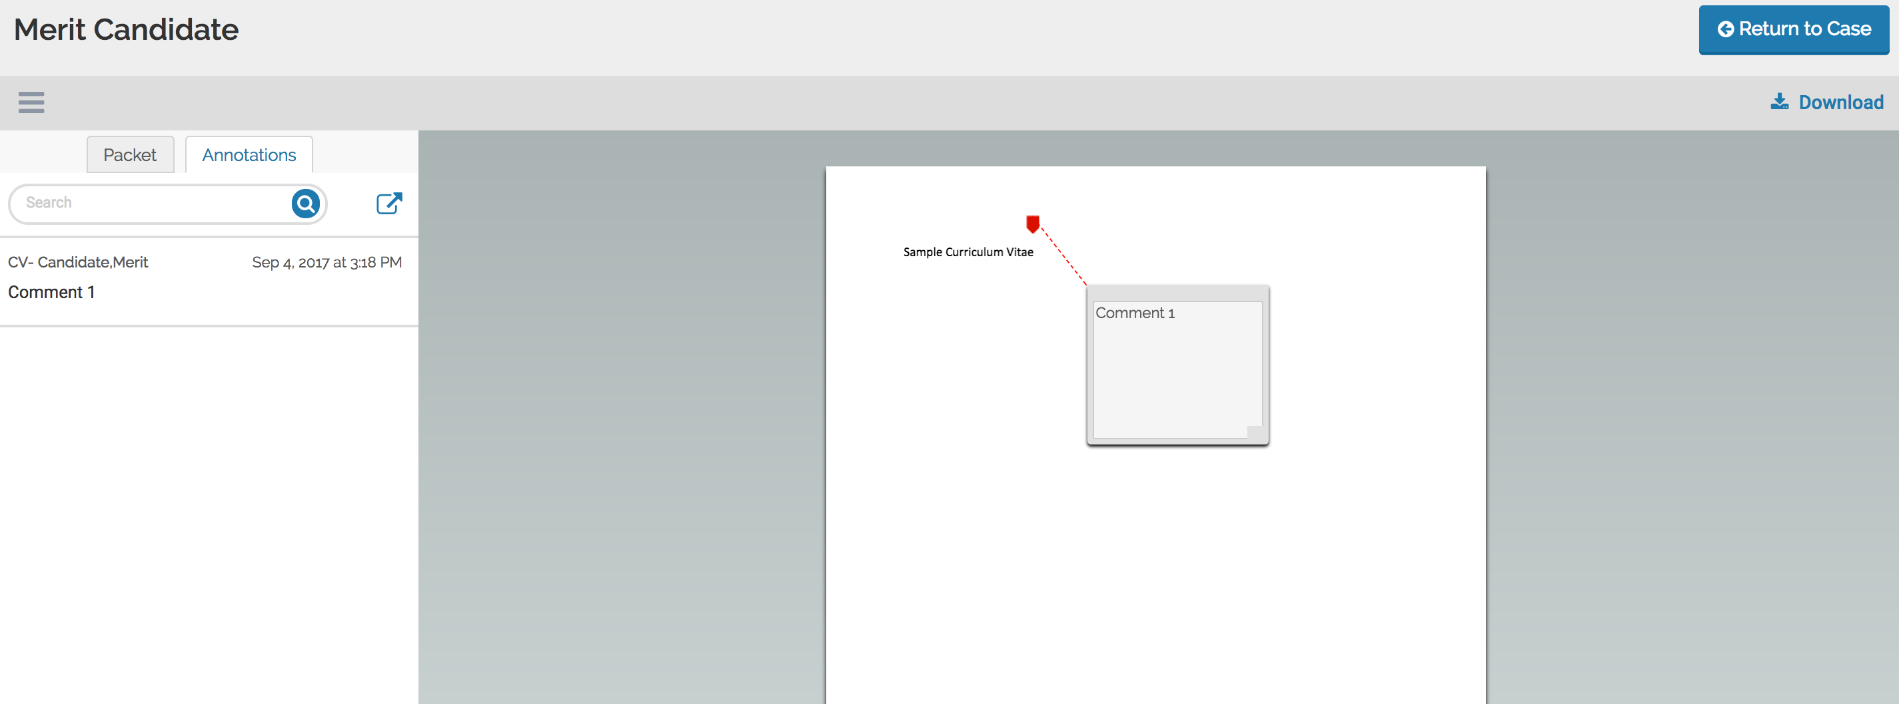
Annotations can also be exported in the form of PDF.
To export all your annotations, Please click on the “Annotations” tab and then click on the export button shown with an arrow in the screenshot below.

Slide 7
Downloading Case from ACRS

Slide 8
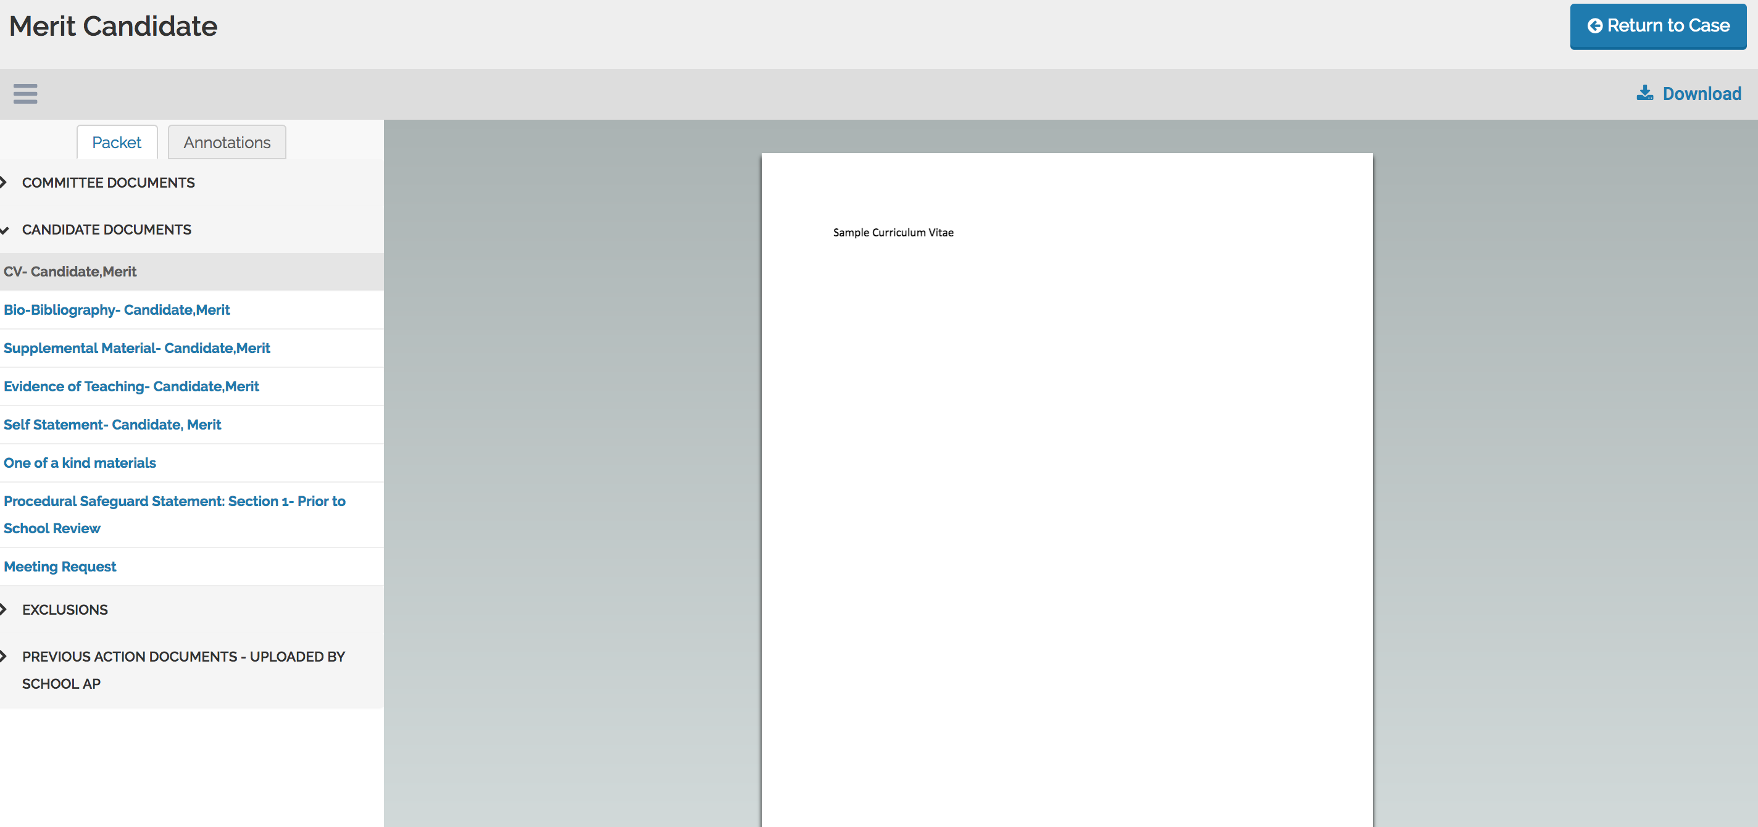
If you prefer to read the case offline, please click on “download” button located on the top right corner of the screen.

Slide 9
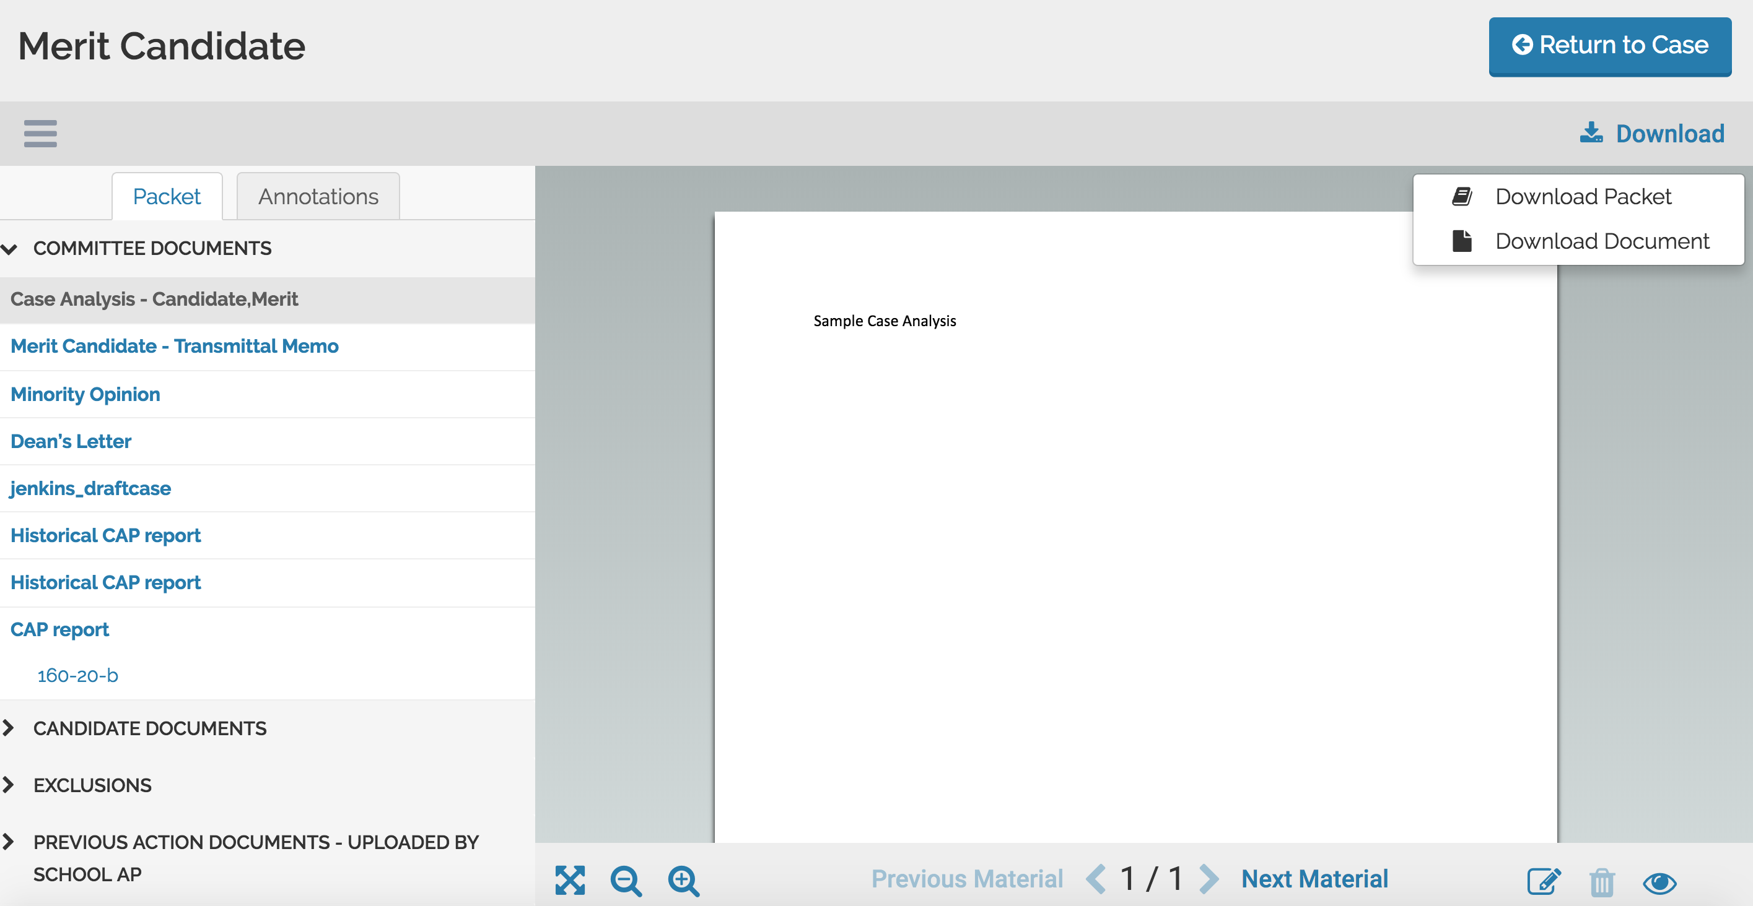

Slide 10
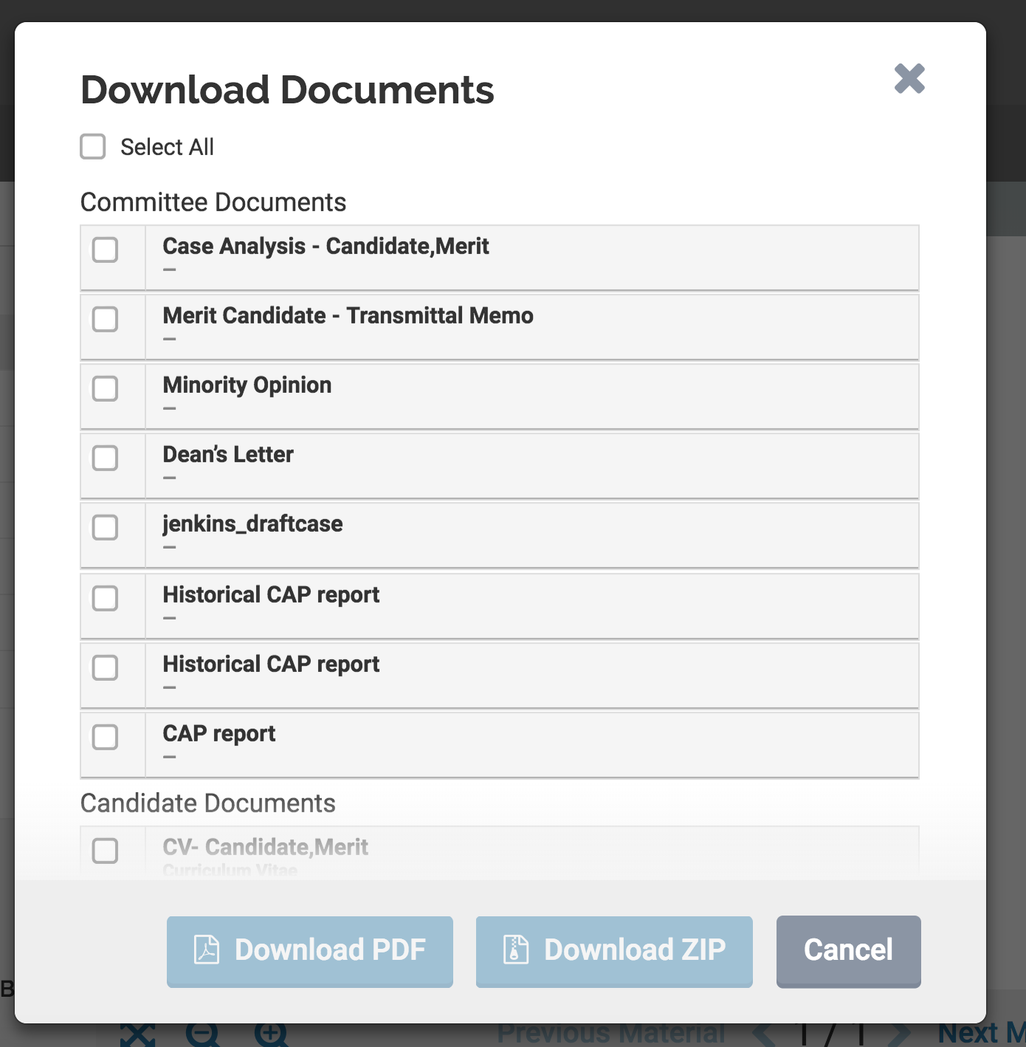
Downloading Packet

Slide 11
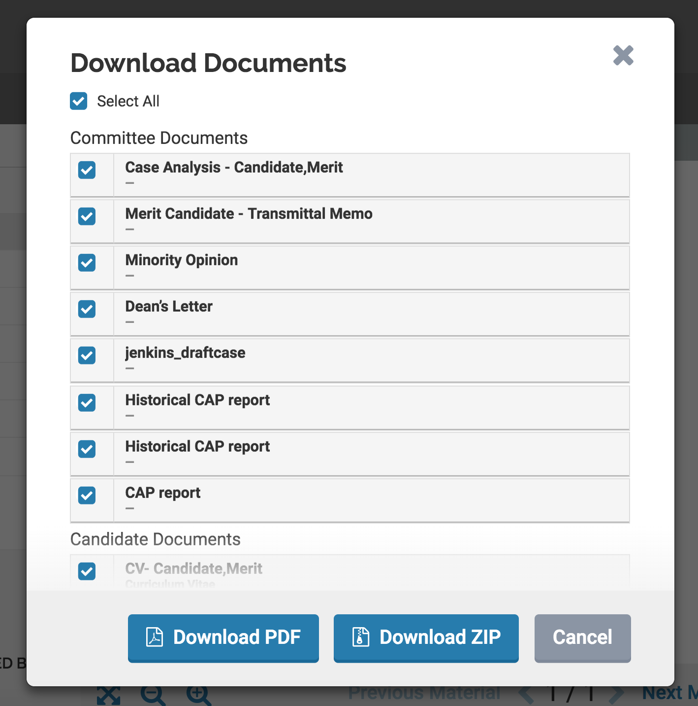
Please click on ”select all” to download the entire packet.
You may then choose to download it in the form of a PDF or a zip file.

Slide 12
Once you click on Download Zip or Download PDF and a secure link is sent to your email inbox. You may ignore the email and directly click on “return case”.

Slide 13
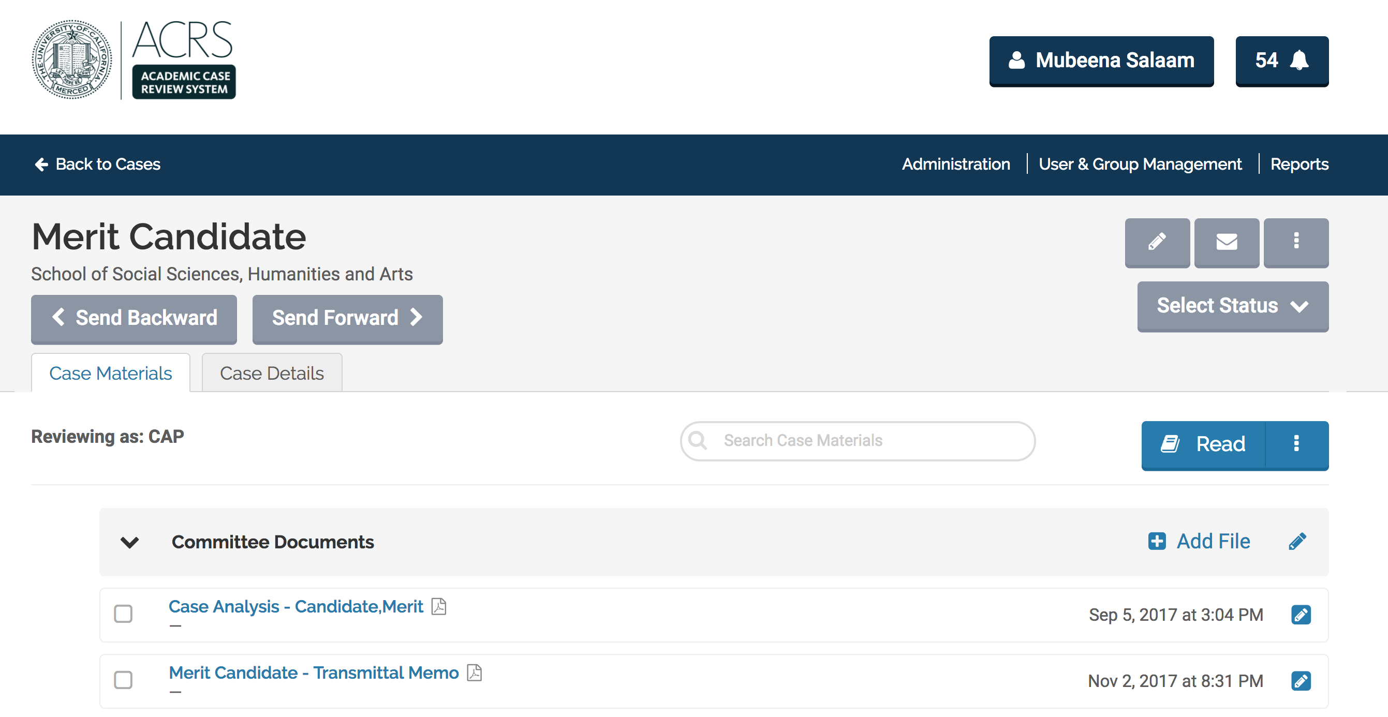
You may now click on the “bell icon”

Slide 14
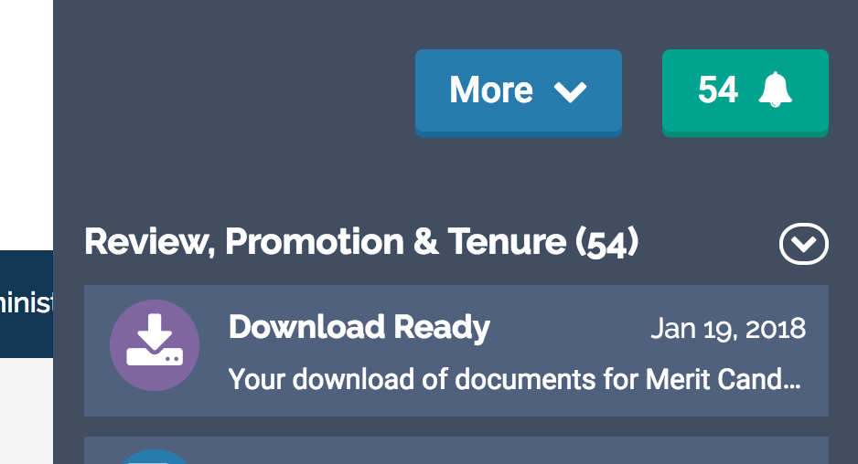
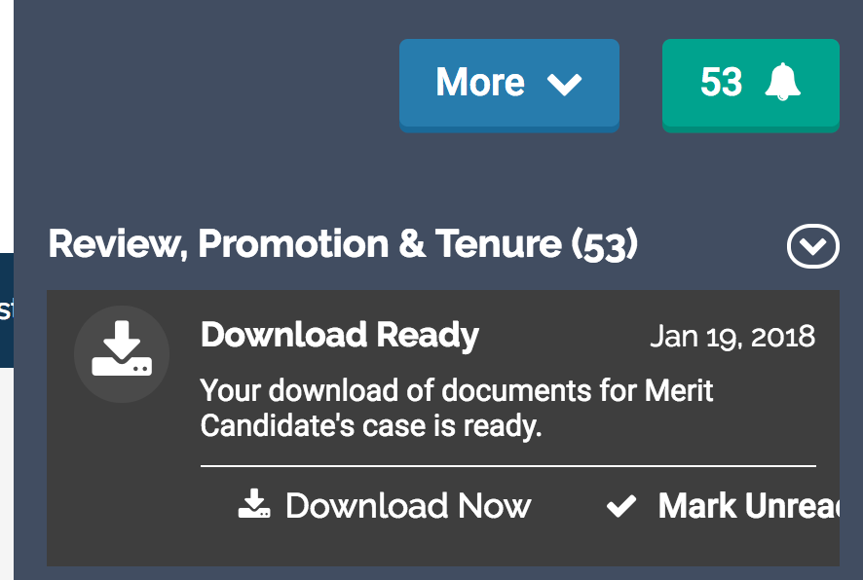
Clicking on “Download Now” will begin the download in your “downloads” folder on your computer.

